Slide 1





Karate API Testing Tutorial
Pramod Dutta Lead SDET.
What is Karate, GET CALL?

Slide 2
Why we Need Karate API Testing?
Open source
API Testing, Mocking,
Performance Testing,
UI Automation, Reporting
Parallel Execution
BDD Style, Native JSON/XML support.
Readable syntax.
Mix API and UI test-automation

Slide 3
Why we Need Karate API Testing?
Can Handle
Web Socket support
SOAP request
HTTP
Browser cookie handling
HTTPS
HTML-form data
XML request

Slide 4
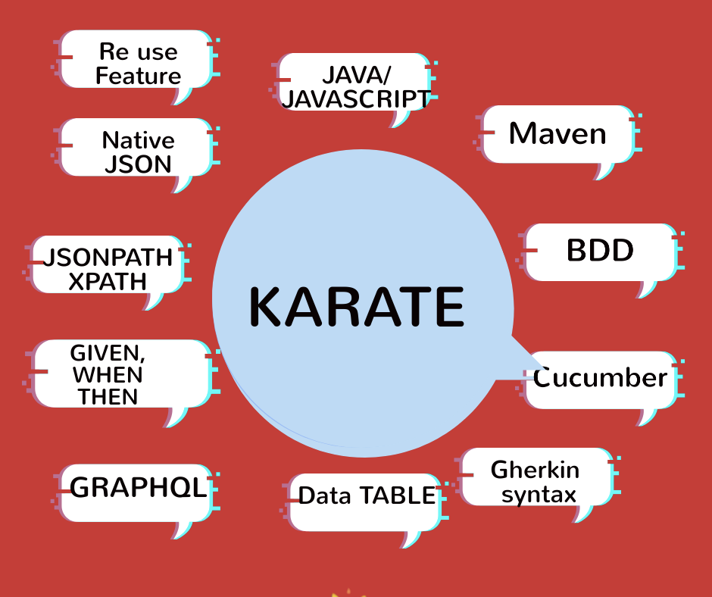
Why we Need Karate API Testing?

Slide 5
What is Karate Test Framework?
Karate is BDD testing framework
Developer by Peter Thomas in 2017 (intuit).
Cucumber style of writing the program which follows the BDD approach.
Easy to understand by non-programmers
Only API testing tool that can Mock, Do performance testing, Mix UI Automation Testing.
Written in Java.
Reuse features, Embed JS engine., Multi Thread parallel Execution.

Slide 6
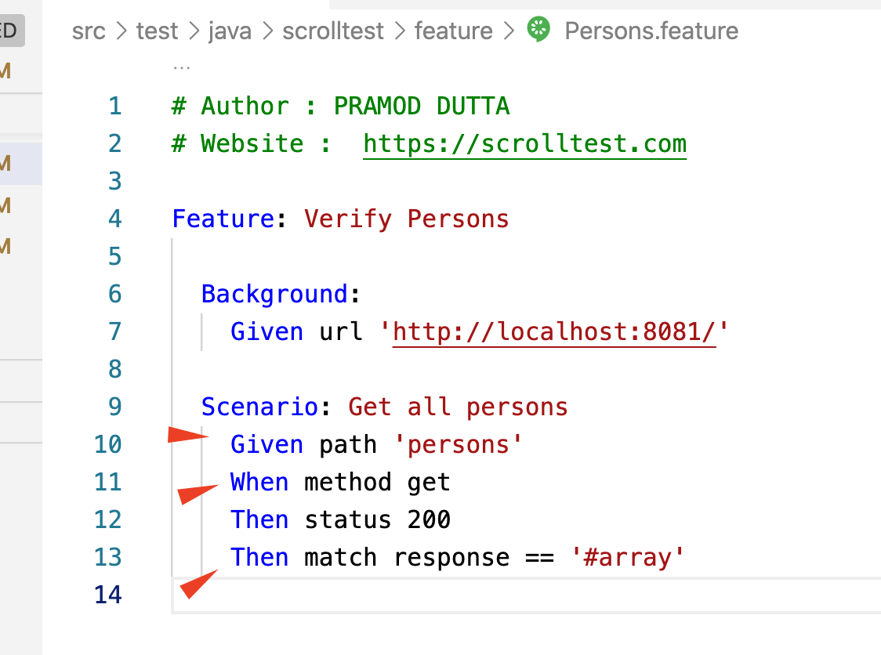
Karate Files
Like Cucumber Feature Files with Gherkin Syntax.

Slide 7
Karate VS Rest Assured.
Karate vs Rest-assured.docx

Slide 8
What You should Know before Learning Karate API?
HTTP Protocols
JSON
Java Knowledge, (Basics of Javascript also)
Maven
Gherkin Syntax

Slide 9
First GET Call with Karate.
Install JDK 8(Java in path)
Install Maven
Sad no intellisense
Install Visual Studio Code.
Extensions
Karate Runner

Slide 10
First GET Call with Karate.
Demo NOW.

